Slide 1

Corporate Presentation
Hardware and Software for Building Automation
www.domat.cz

Slide 2



  Founded in 2004
  Complete Buildings Automation and Energy Management Portfolio
  One of the Leading Building Automation Providers in the Czech Republic
  Trusted by Customers in 27 Countries Worldwide
  Annual Revenue Exceeding EUR 12 Million and 100+ Professionals
www.domat.cz

Slide 3
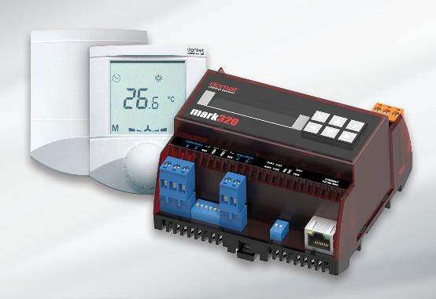

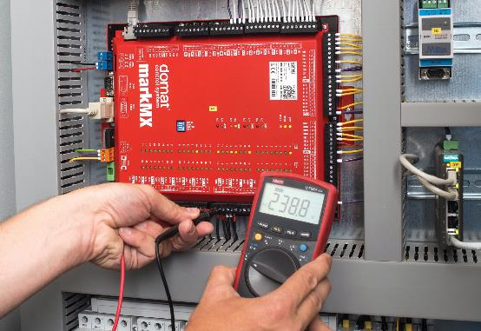
  BUILDING AUTOMATION PRODUCTS
  TURNKEY BMS & ENERGY MANAGEMENT SOLUTIONS
  SECURE DATA COLLECTION AND PROCESSING
  SOFTWARE DEVELOPMENT, SERVICE AND SUPPORT
www.domat.cz

Slide 4

MARKET SEGMENTS
  BUILDINGS
  Smart control solutions for offices, retail centres, hotels, healthcare facilities, educational campuses, sports venues, logistics hubs and industrial sites.
  ENERGY
  District heating, energy metering, peak demand control, heat pump control and photovoltaic plant monitoring. Domat is a leading monitoring provider for solar power plants in the Czech Republic and Slovakia.
  Wherever energy efficiency, operational reliability and occupant comfort matter.
www.domat.cz

Slide 5

BUILDING REFERENCES
  VIP Partners:
  Interspar and Spar – 300 properties (HU, SLO, HR), BILLA – 300 properties , Penny Market – logistics centres, AmRest : KFC, Starbucks, BurgerKing, Porsche Inter Auto, Popeyes
  Selected References in the Czech Republic and Abroad:
  Teluria Skrchov – paint and coatings production, hazardous (Ex) areas, integration with production proc
  TechnicPark Prague – cleanroom facilities
  Eden Stadium (Slavia Prague)
  IMPACT – centre for combating cyber terrorism (Malaysia)
  Luanda Hospital (Angola)
  Czech Embassies in Brussels, Tokyo (Japan) and London (United Kingdom)
  Galerie Harfa, Prague
  Main Point Pankrác (MPP) and V Tower
  Hilton Rijeka Costabella Beach Resort & Spa, Croatia
  Majaland, Prague
  Lidl Logistics Centre, Buštěhrad
  Imperial Spa, Karlovy Vary
  Prague Planetarium
  Rohan City – residential buildings
  Pardubice Region Hospitals
www.domat.cz

Slide 6

ENERGY REFERENCES
  One of Central Europe's largest air-to-water heat pump applications for residential districts
  Control and monitoring of the district heating network in Trencin, Slovakia
  Monitoring and control of photovoltaic installations with a combined capacity exceeding 418 MWp (CZ, SK, DE, BE, IT, BG), including two of the three largest CEZ photovoltaic plants: Sevetin (27 MWp) and Vranovska Ves (16 MWp)
  Local Distribution Systems (LDS): data acquisition and billing metering for approx. 5,000 metering points
www.domat.cz

Slide 7
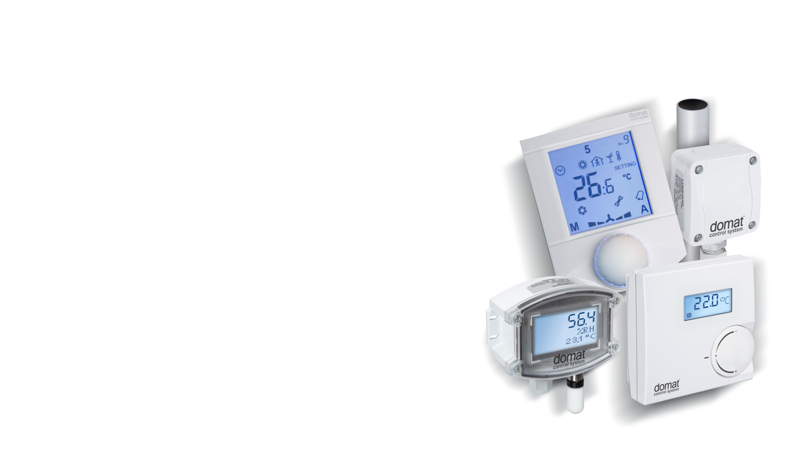
PRODUCT PORTFOLIO
FIELD DEVICES
  Complete Domat Field Device Portfolio
  Temperature, humidity, pressure, air quality (VOC, CO2) and light intensity sensors for indoor and outdoor applications
  Air and water thermostats
  Safety and emergency devices
  Valves and actuators up to DN150 for hot water, air and cooling media
www.domat.cz

Slide 8
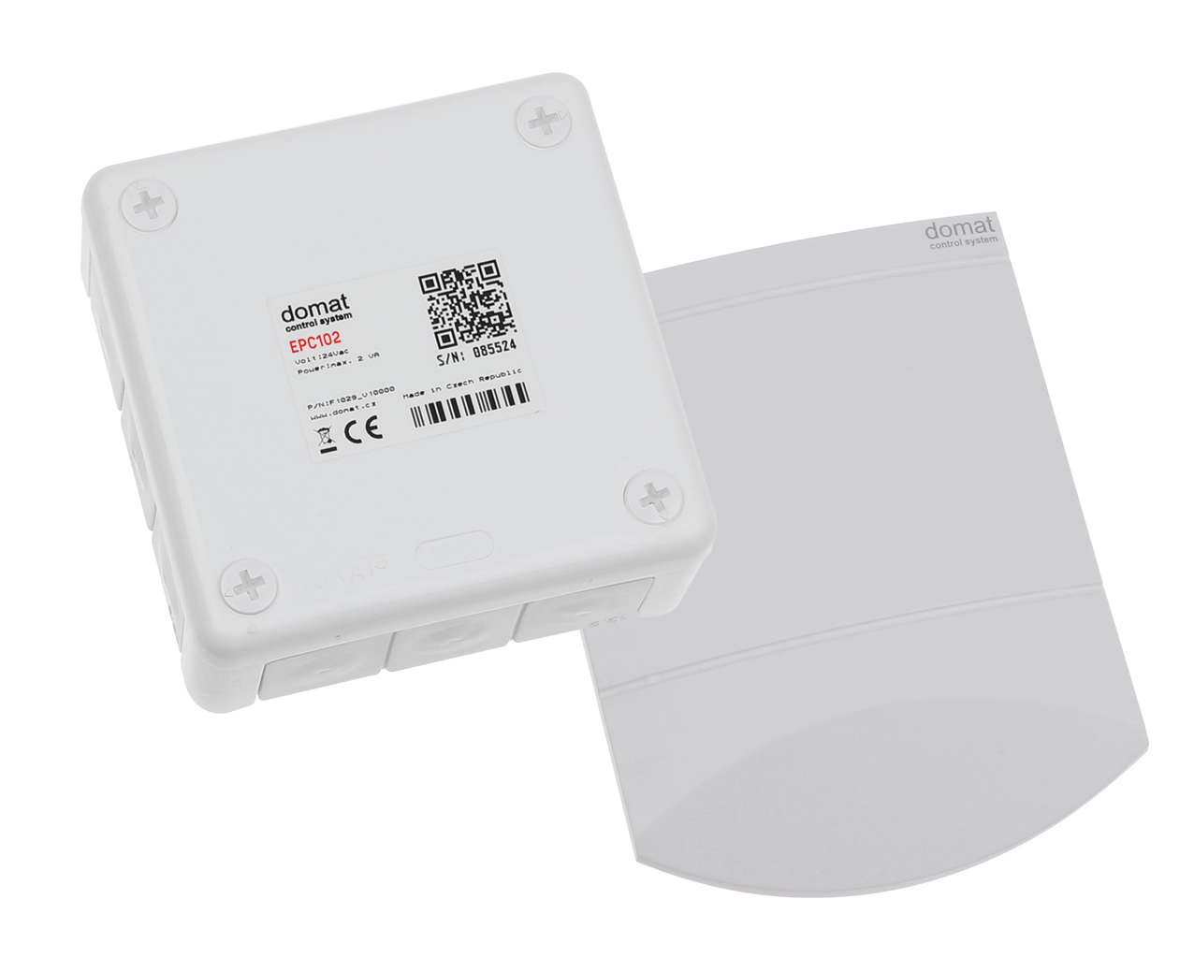
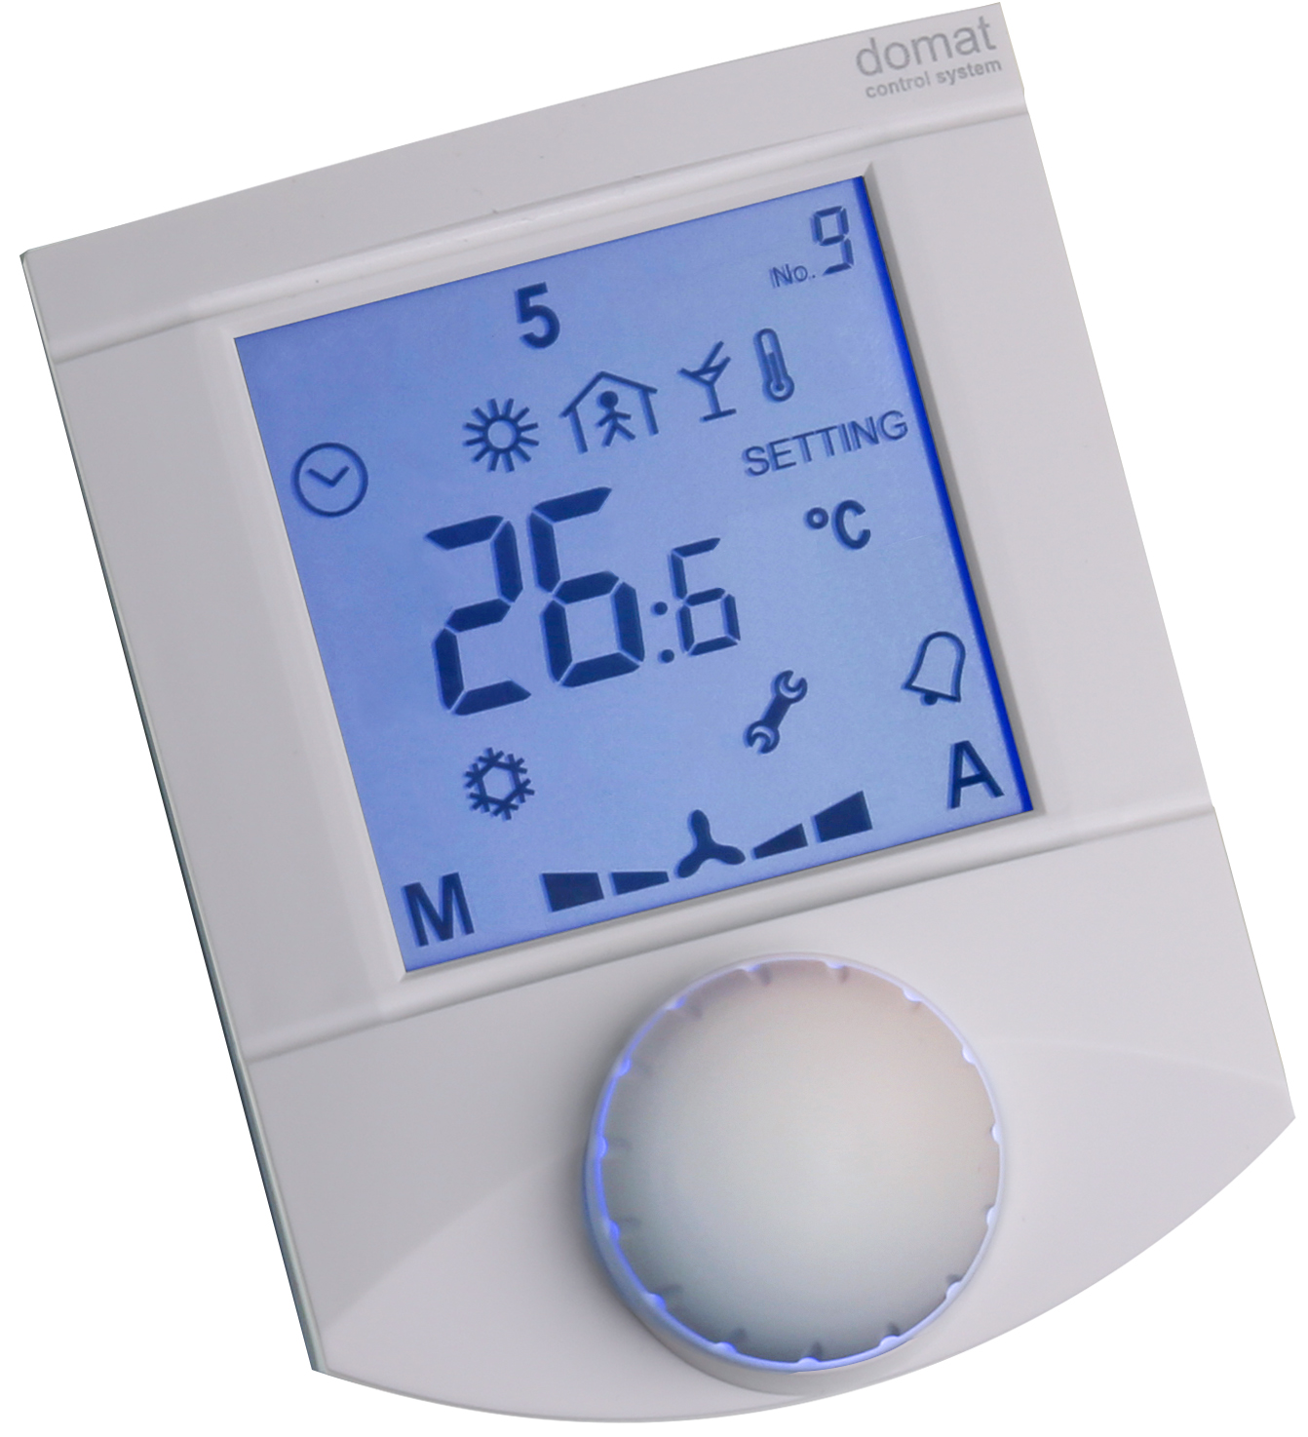
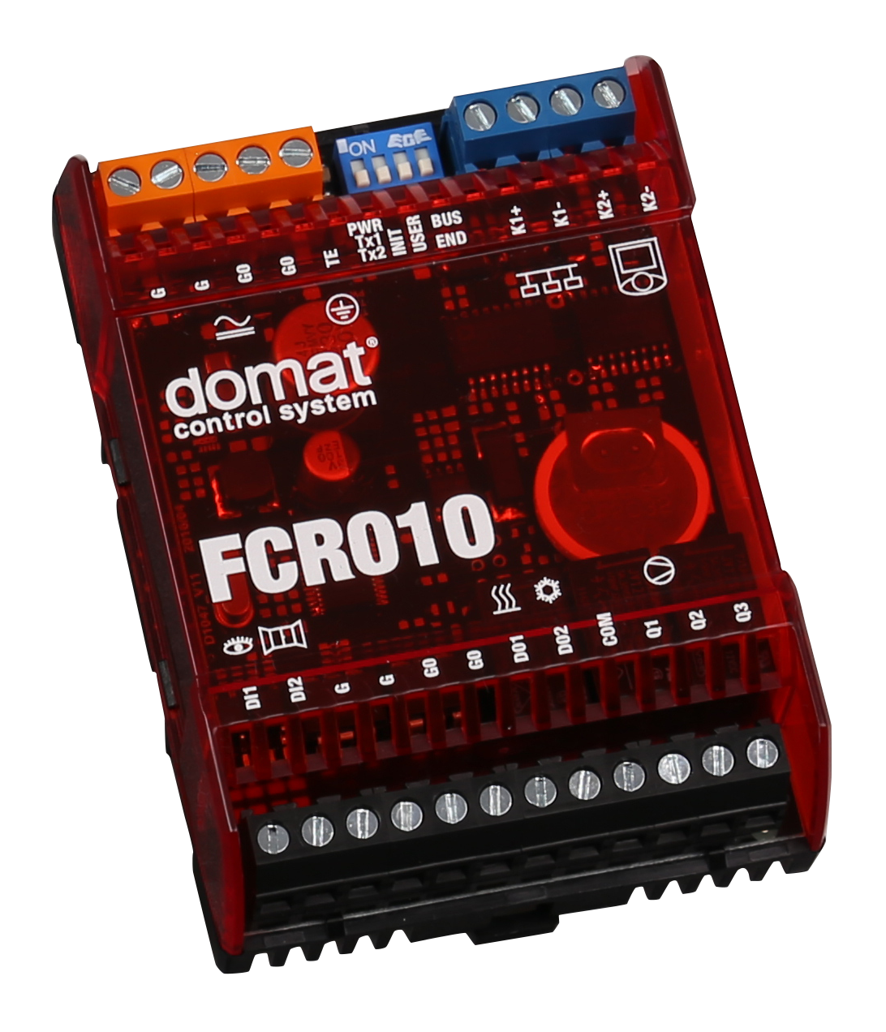
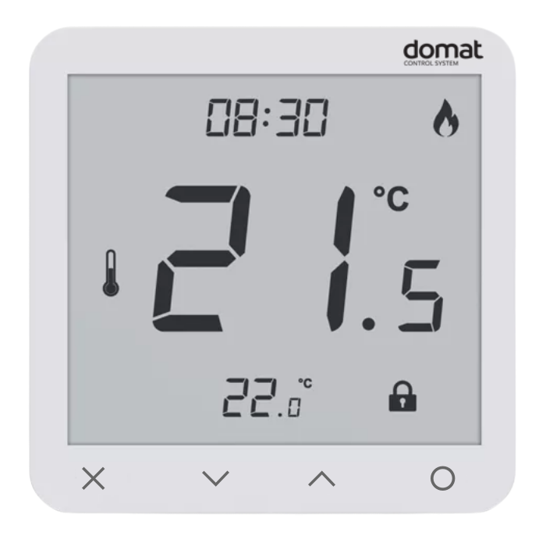
PRODUCT PORTFOLIO
ROOM OPERATORS AND CONTROLLERS
  Developed and manufactured in the Czech Republic
  Individual Room Control (IRC)
  Wide range of products for various applications: room operators, controllers, fan coil controllers and controllers suitable for EPC projects
  Standalone operation or integration with higher-level PLC systems
  Easy commissioning with extensive configuration options
www.domat.cz

Slide 9
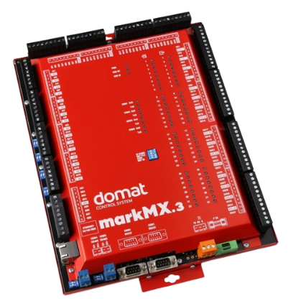
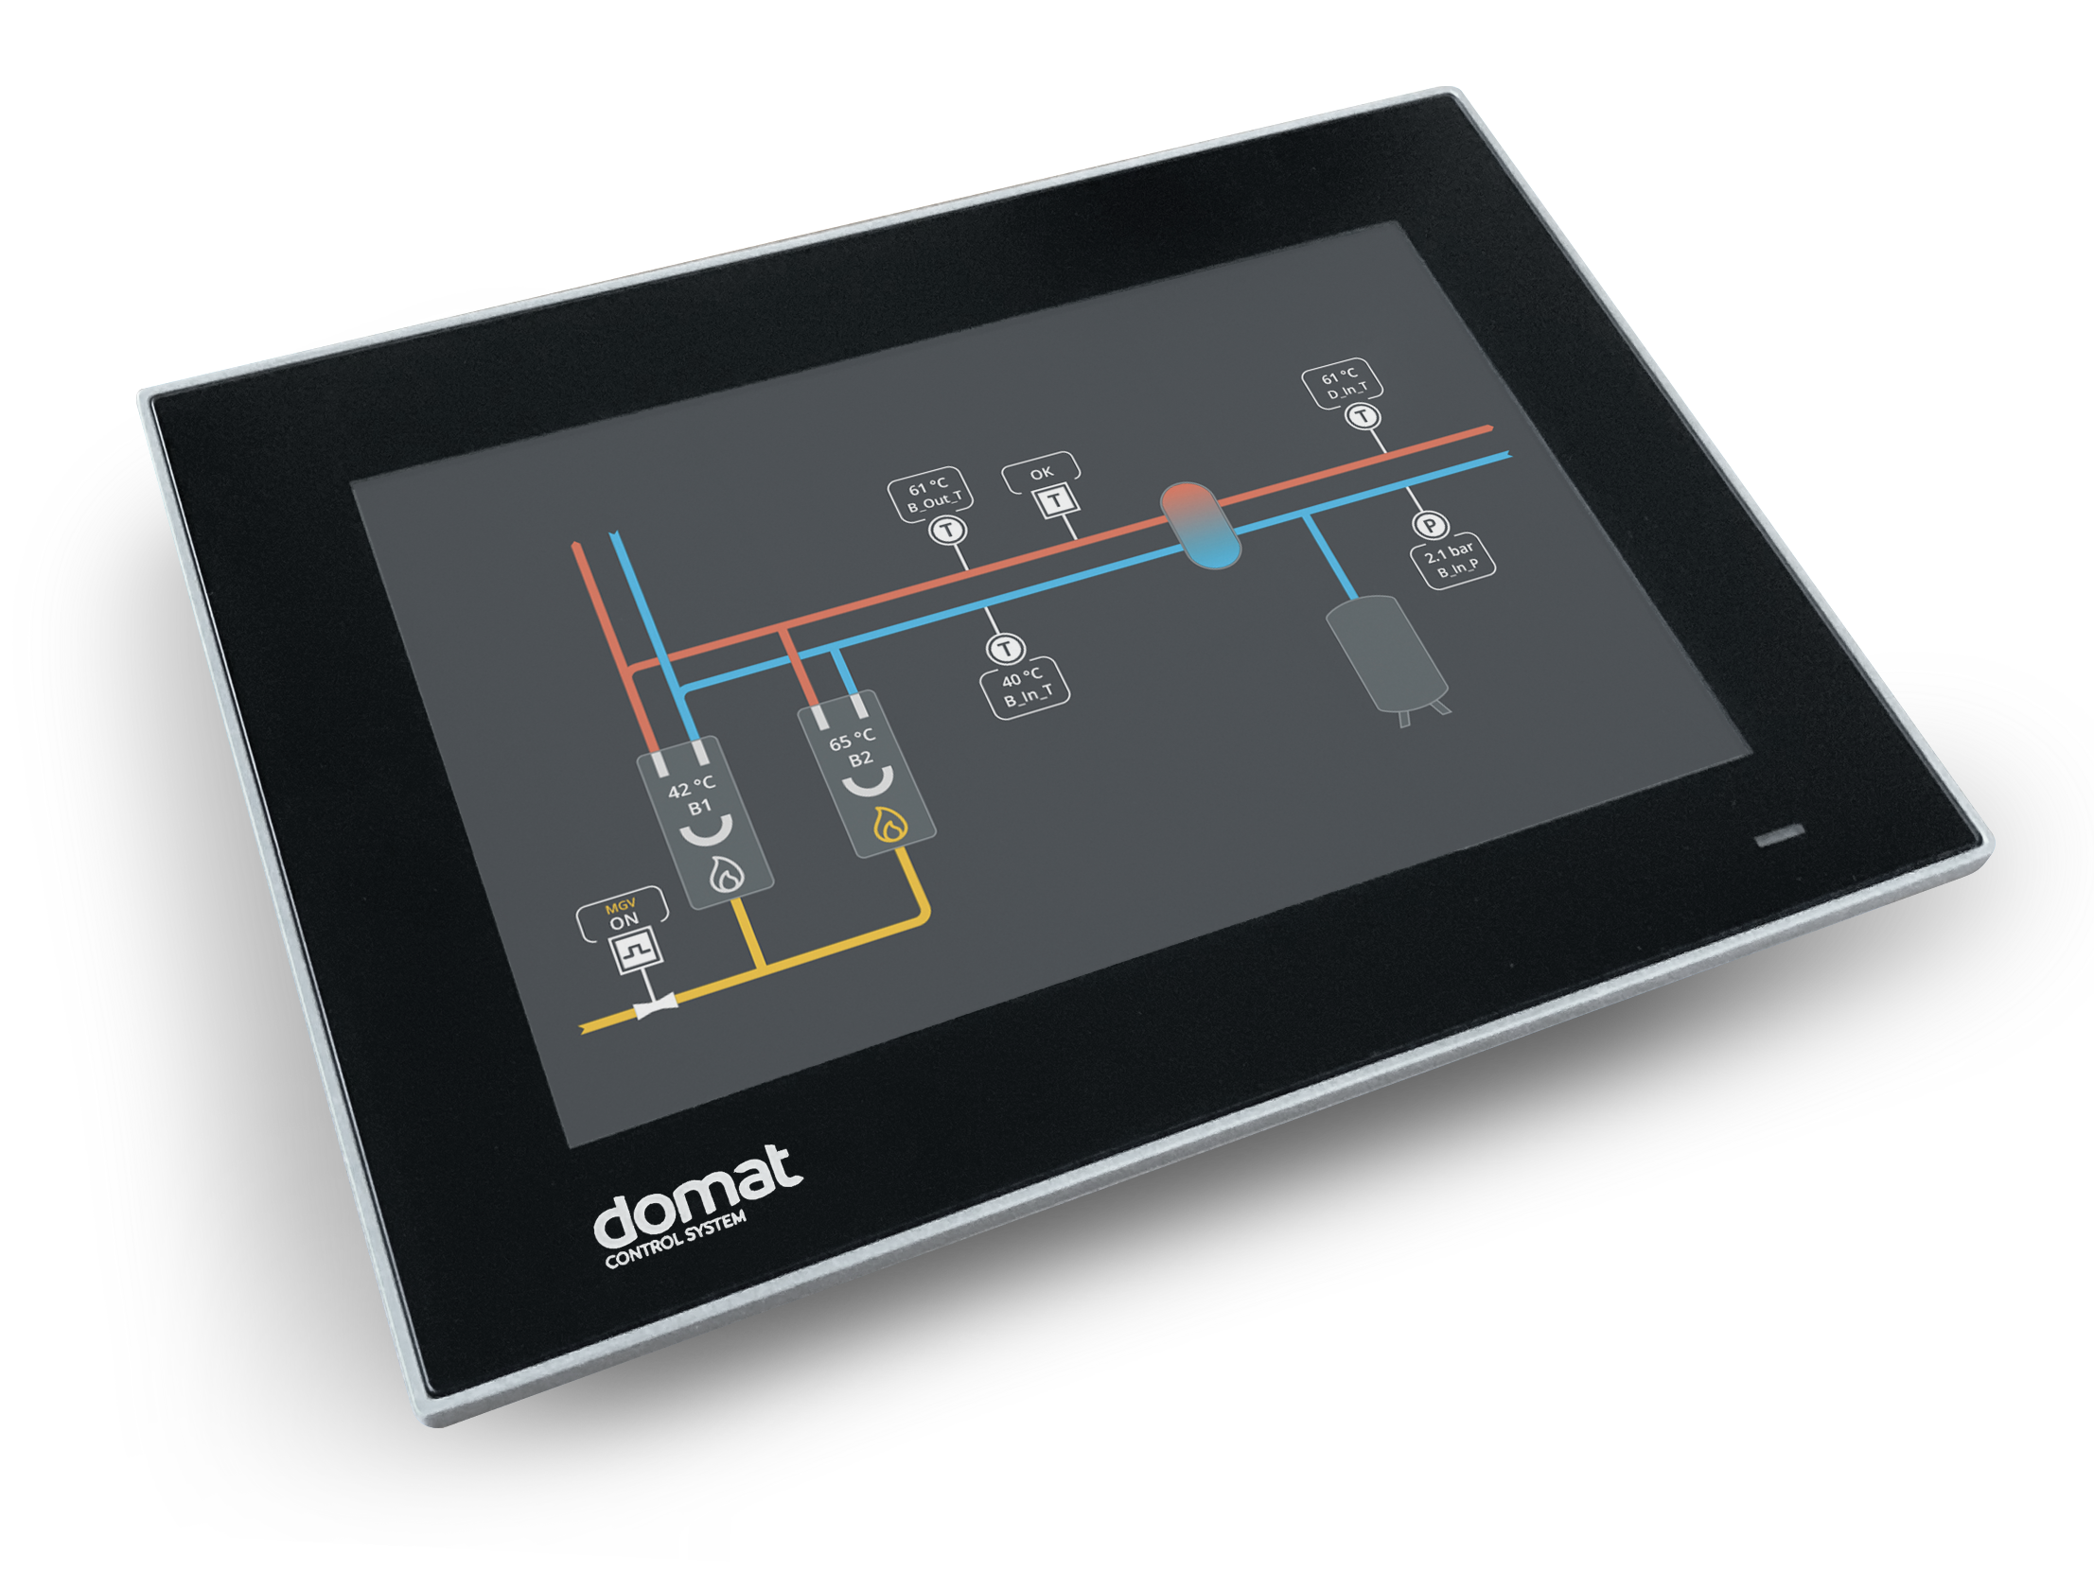
PRODUCT PORTFOLIO
PLC CONTROLLERS AND HMI PANELS
  Developed and manufactured in the Czech Republic
  Process stations and PLC controllers
  Expansion I/O modules and distributed I/O
  Extensive third-party device integration options
  Wide range of converters between standard protocols and physical buses
  Graphic touch panels (7", 10", 15")
www.domat.cz

Slide 10
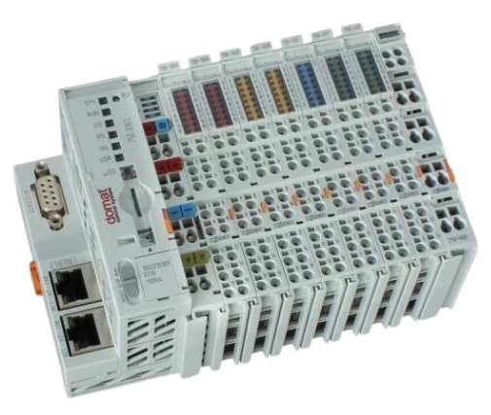
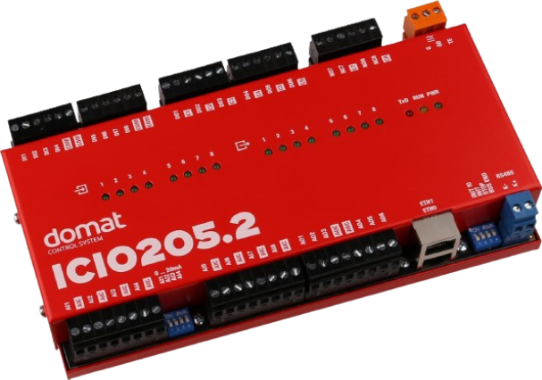
PRODUCT PORTFOLIO
MARK AND WALL CONTROLLERS
  Two flexible controller families for different project requirements:
  wall - card-based controller system
  mark - modular controller system
www.domat.cz

Slide 11

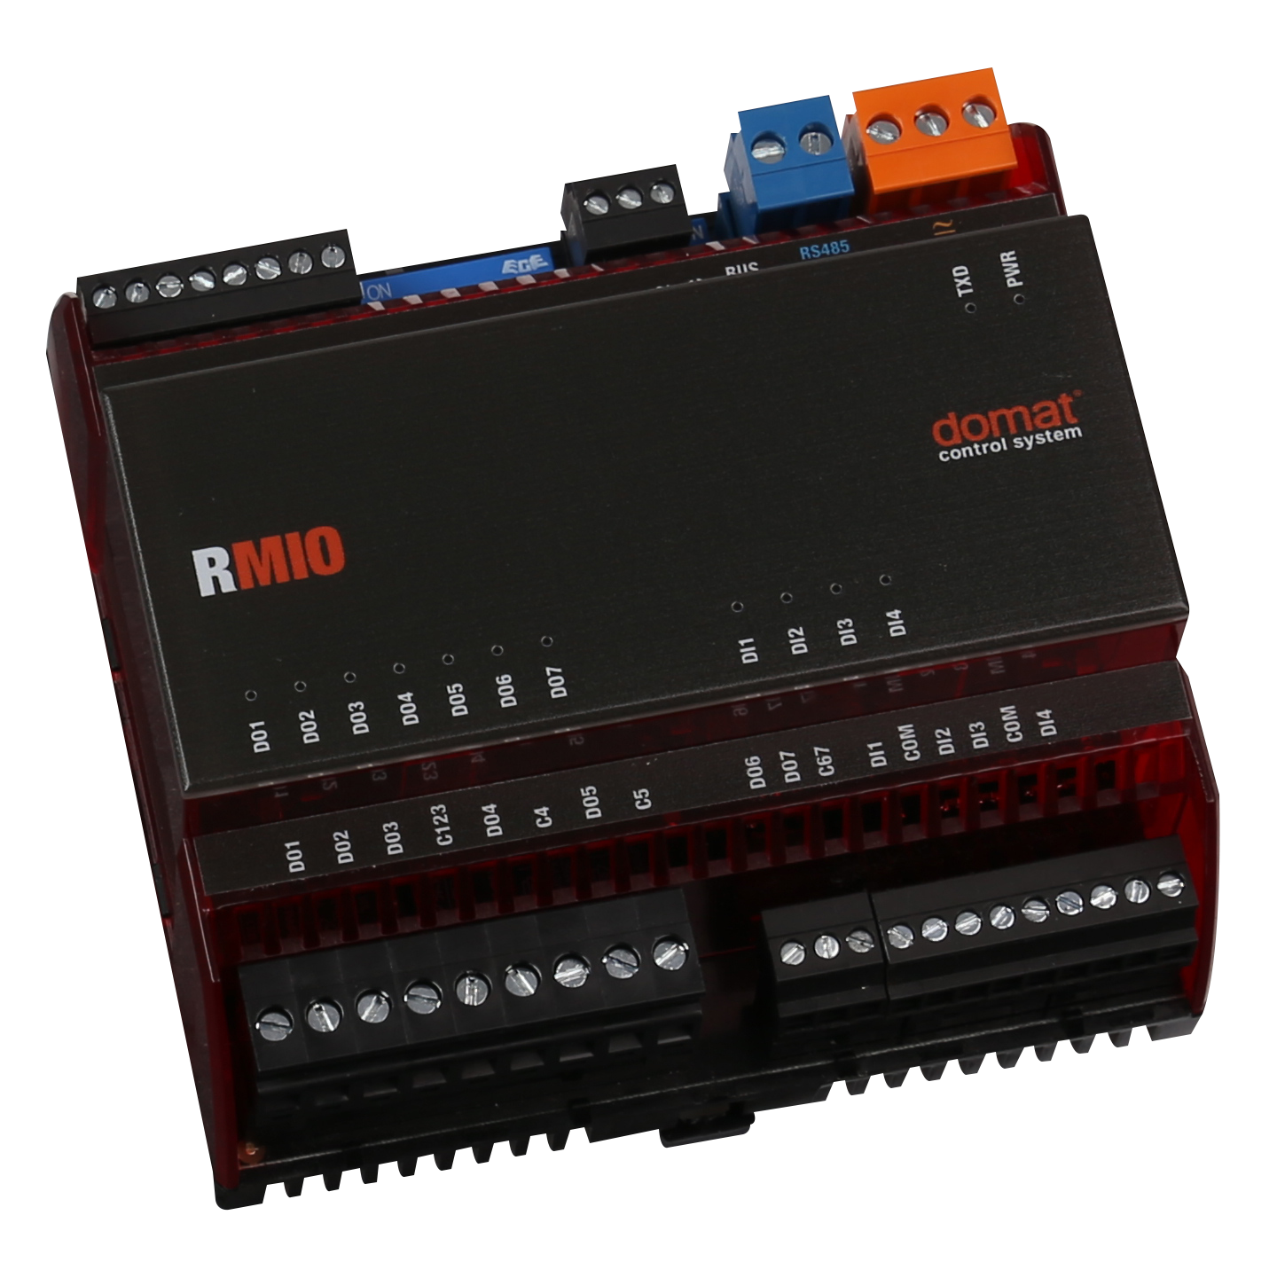
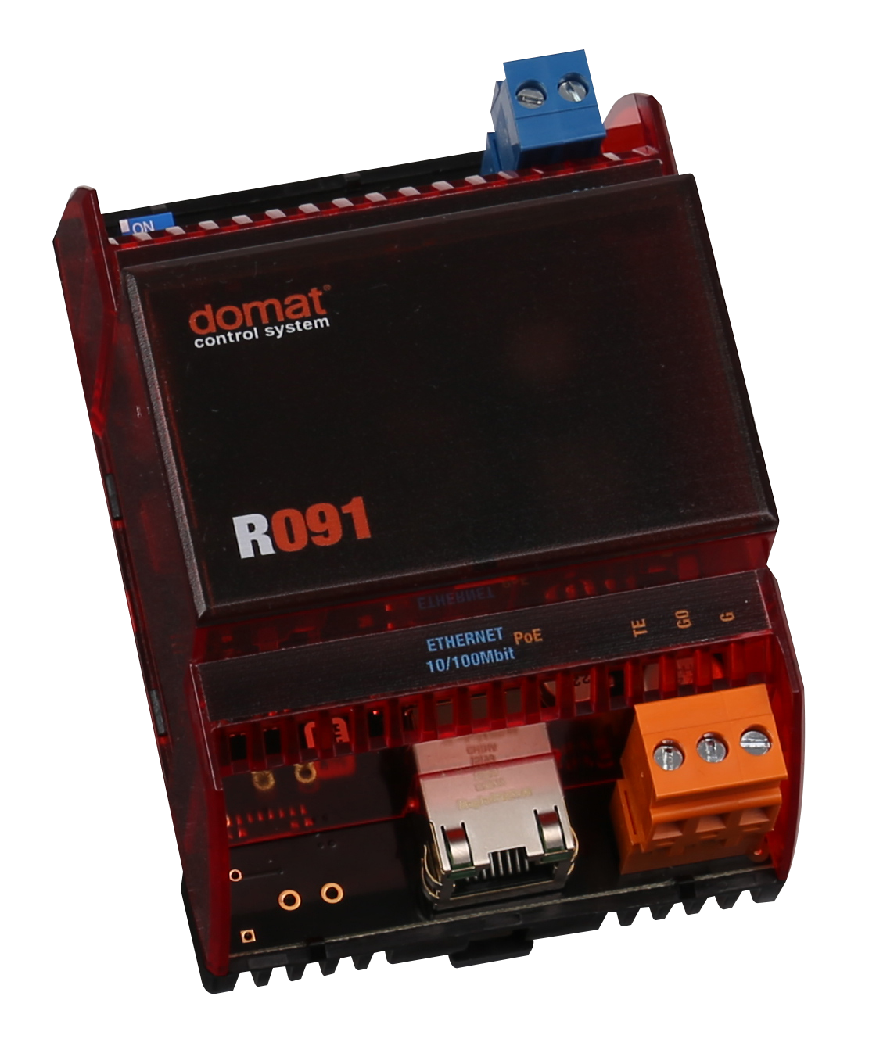
PRODUCT PORTFOLIO
INTEGRATION GATEWAYS AND I/O MODULES
  Developed and manufactured in the Czech Republic
  Various DI, DO, AO and AI I/O module variants
  Converters for RS485, RS232 and Modbus to Ethernet, including protocol-to-protocol conversion
  DALI lighting integration gateways
  Gateways for third-party buses: Landis&Gyr P-bus I/O, SAUTER DL bus and BELIMO MP-bus
  M-Bus energy meter integration gateways
www.domat.cz

Slide 12


OPEN CONNECTIVITY
  Seamless integration with building technologies, energy systems and third-party platforms.
  Open protocols: OPC Client/Server, Modbus RTU/TCP, Modicon Standard, BACnet and DDE Client
  Proprietary protocols: DDC and PLC protocols, including approximately 60 communication drivers for devices from Siemens, JCI, Sauter, Honeywell and others
  Energy metering: M-Bus support for up to 60 meter types and manufacturers, with additional types available upon request
  Custom communication driver development supported by an extensive existing driver library
www.domat.cz

Slide 13
SOFTWARE PLATFORM FOR ENERGY MANAGEMENT AND BUILDING CONTROL
  Domat PROXY - enables secure access to PLCs in a LAN without requiring a public IP address.
  Domat WEB - PLC web server for HMI pages created in the HMI Editor integrated into Domat IDE.
  Domat RUNTIME - software license for running compiled Domat projects.
  Domat OPC - communication interface for remote monitoring, control and integration with external applications.
www.domat.cz

Slide 14

POWERFUL ENGINEERING PLATFORM
  Proven IEC 61131-3 programming approach using Function Blocks and Structured Text
  Integrated HVAC libraries
  Online supervision, monitoring and maintenance
  Remote control including structural modifications
  Same engineering workflow across different hardware platforms
www.domat.cz

Slide 15


MODERN VISUALIZATION AND USER EXPERIENCE
  Free graphical editor for creating touch panel screens
  Web visualization directly in PLCs with graphical panel operation: online trends, time schedules and alarms
  Multiple control levels: local LCD displays, text or graphical terminals and visualization systems
  Open system with integration protocols for third-party visualization platforms
  Free OPC server
www.domat.cz

Slide 16
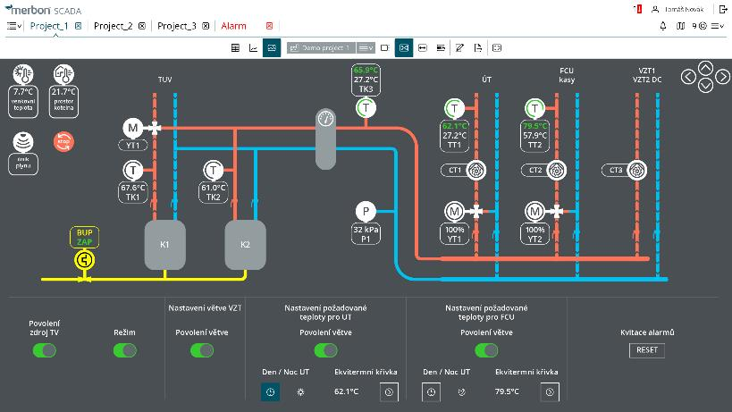
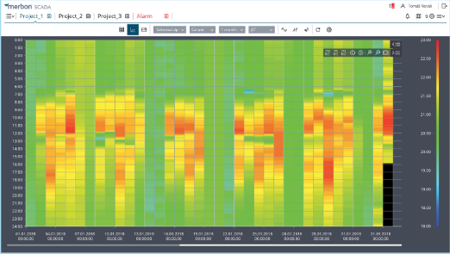
ENTERPRISE SCADA AND MONITORING
  Access your buildings and energy systems anytime, anywhere through a web browser.
  Graphical diagrams and floor plans with animations, user notes and control functions
  Historical data analysis: line, bar, modulo, differential and carpet charts
  Data export and sharing via HTML links, images, tables or text
  User and role management, access logs
  Alarm handling including communication failure management
  Technical overview through data point tables
  Fast search and filtering within tree structures, followed by selection and action handling
www.domat.cz

Slide 17


WHY DOMAT?
SYSTEM BENEFITS
OUR VALUES
  Open and interoperable platform
  Complete hardware and software ecosystem
  Strong focus on energy efficiency
  Long-term technical partnership
  European development and manufacturing
  Responsibility
  Proactivity
  Flexibility
  Innovation
  Quality
www.domat.cz

Slide 18
THANK YOU
Domat Control System s.r.o. - www.domat.cz
Headquarters
U Panasonicu 376
530 06 Pardubice
Czech Republic
Klecany Branch
Trebizskeho nam. 424
250 67 Klecany
Czech Republic
Brno Branch
Turanka 1222/115
Slatina
627 00 Brno
Czech Republic
2026 © Domat Control System s.r.o.
www.domat.cz

